Slide 1
AI for Everyone
Prepared by Adil Altaf
March 4, 2019

Slide 2
Audience
If you want to:
know what’s behind the buzzwords
use AI yourself
understand how AI is affecting society and how to navigate that
Prerequisite:
None

Slide 3
Objectives of this Course
The meaning behind common AI terminology, including neural networks, machine learning, deep learning, and data science
What AI realistically can--and cannot--do
How to spot opportunities to apply AI to problems in your own organization
What it feels like to build machine learning and data science projects
How to work with an AI team and build an AI strategy in your company
How to navigate ethical and societal discussions surrounding AI

Slide 4
Procedure

Slide 5
Introduction
Building AI in your Company
Conclusion & Review
30 minutes
60 mins
60 mins
60 mins
30 mins
Building AI Projects
AI and Society

Slide 6
Introduction

Slide 7
$13 Trillion
AI value creation by 2030
Source: McKinsey Global Institute

Slide 8
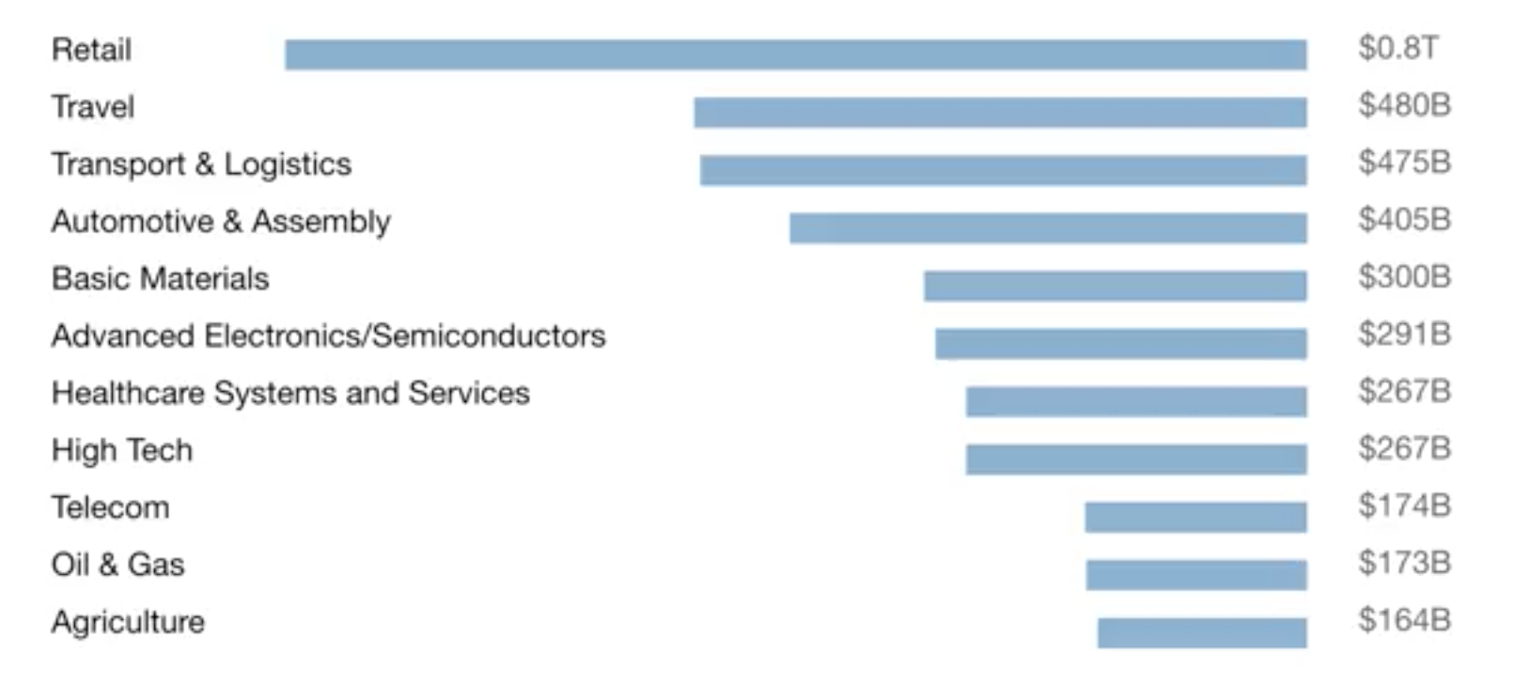
A lot of the value created by AI will be outside the software industry. AI will have a huge impact on all the major industries.

Slide 9
There are 2 types of AI
ALMOST NO PROGRESS
ANI
Artificial Narrow Intelligence
AGI
Artificial General Intelligence
LOTS OF PROGRESS
Notes:
There is a lot of excitement but also a lot of unnecessary hype about AI.
AI is actually two separate ideas.

Slide 10
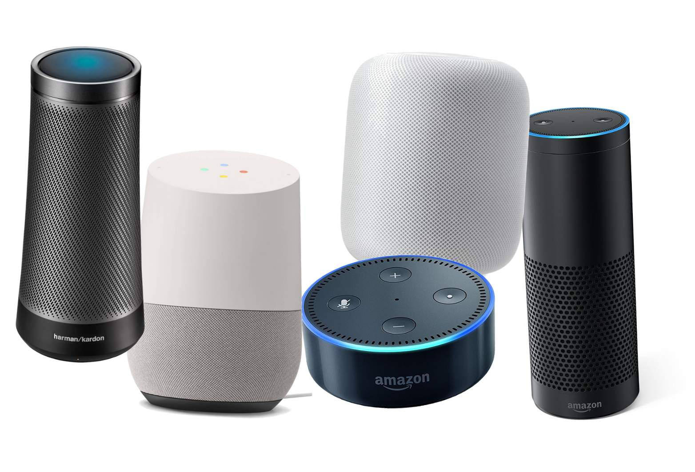
Artificial Narrow Intelligence (ANI)
These are AIs that do one thing such as:
smart speaker
self-driving car
AI to do web search
AI applications in farming or in a factory.
These types of AI are one trick ponies but when you find the appropriate trick, this can be incredibly valuable.

Slide 11

Artificial General Intelligence (AGI)
That is the goal to build AI.
They can do anything a human can do or maybe even be superintelligent and do even more things than any human can.

Slide 12

Progress in ANI vs AGI
The rapid progress in ANI has caused people to conclude that there's a lot of progress in AI, which is true. But that has caused people to falsely think that there might be a lot of progress in AGI as well which is leading to some irrational fears about evil clever robots coming over to take over humanity anytime now.

Slide 13
Achieving AGI Will Take Time
AGI is an exciting goal for researchers to work on, but it requires many technological breakthroughs before we get there and it may be decades or hundreds of years or even thousands of years away.

Slide 14
What You Will Learn?
What is AI?
Machine learning
Data
What makes an AI company
What machine learning can and can not do
Intuitive Explanation of Deep Learning
Building AI Projects
Building AI in Your Company
AI and Society

Slide 15
Machine Learning
The rise of AI has been largely driven by one tool in AI called machine learning.
You will start thinking how machine learning might be applied to your company or to your industry.

Slide 16



Supervised Learning
The most commonly used type of machine learning is a type of AI that learns A to B, or input to output mappings. This is called supervised learning.
Input (A)
Email
Output (B)
Spam (0/1)
Application
Spam Filtering

Slide 17



Supervised Learning
If the input is an audio clip, and the AI's job is to output the text transcript, then this is speech recognition.
Input (A)
Audio
Output (B)
Text (0/1)
Application
Speech Recognition

Slide 18



Supervised Learning
If you want to input English and have it output a different language, Chinese, Spanish, something else, then this is machine translation.
Input (A)
English
Output (B)
Chinese
Application
Machine Translation

Slide 19




Supervised Learning
All the large online ad platforms have a piece of AI that inputs some information about an ad, and some information about you, and tries to predict, will you click on this ad or not?
Input (A)
Ad + User Info
Output (B)
Click? (0/1)
Application
Machine Translation

Slide 20


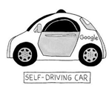

Supervised Learning
If you want to build a self-driving car, one of the key pieces of AI is the AI that takes as input an image, and some information from radar, or from other sensors, and outputs the position of other cars, so your self-driving car can avoid the other cars.
Input(A)
Image, radar info
Position of other cars
Self-Driving Car

Slide 21



Supervised Learning
In Manufacturing, we take as input a picture of something you've just manufactured, such as a picture of a cell phone coming off the assembly line., and you want to output, is there a scratch, or is there a dent, or some other defects on this thing you've just manufactured? This is visual inspection which is helping manufacturers to reduce or prevent defects in the things that they're making.
Input (A)
Image of a phone
Output (B)
Defects (0/1)
Visual Inspection

Slide 22
Supervised Learning
This set of AI called supervised learning, just learns input to output, or A to B mappings. On one hand, input to output, A to B it seems quite limiting. But when you find a right application scenario, this can be incredibly valuable.

Slide 23
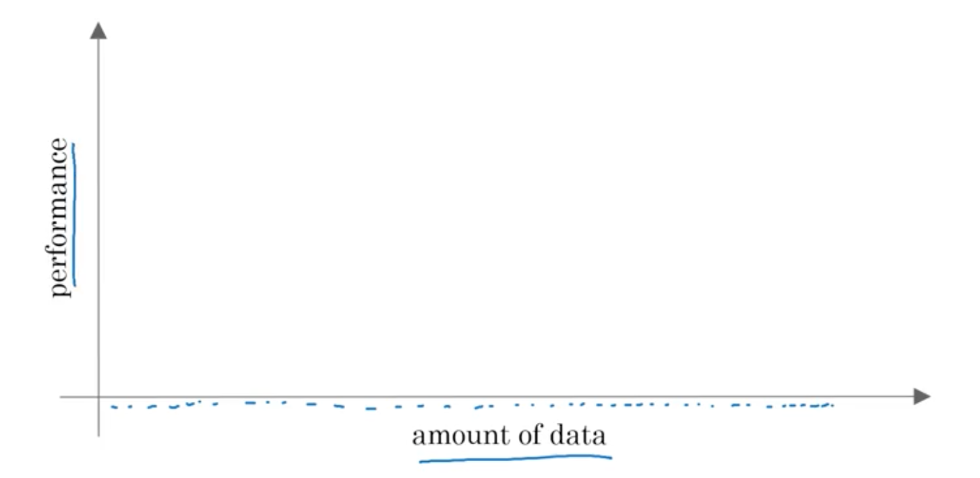
Why Now?

Slide 24
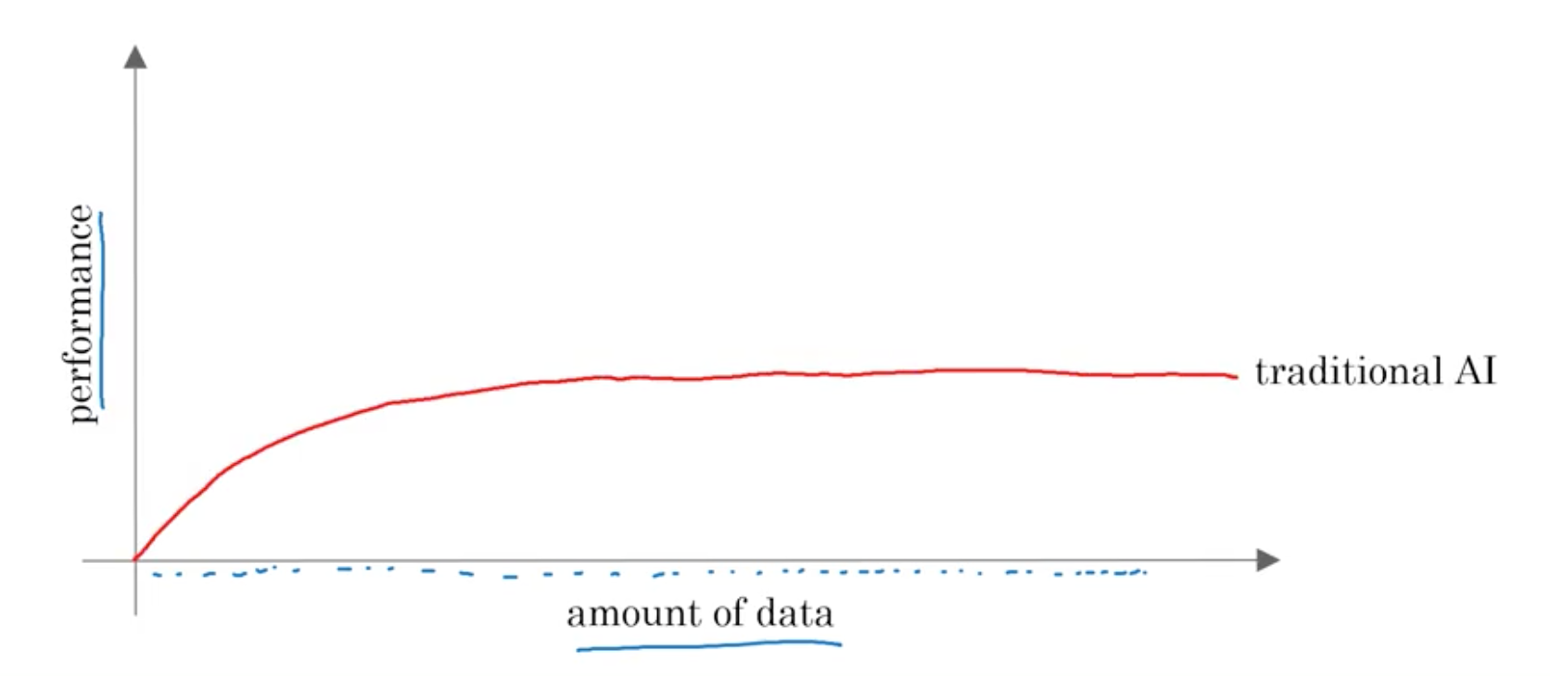
Why Now?

Slide 25
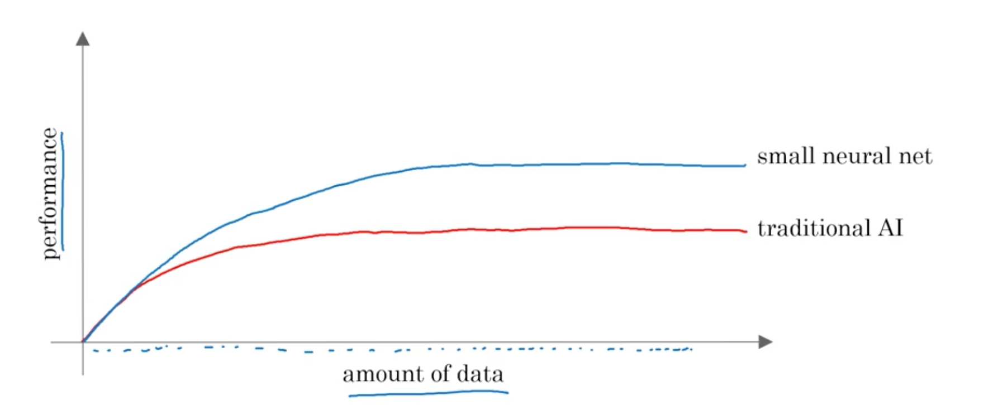
Why Now?

Slide 26
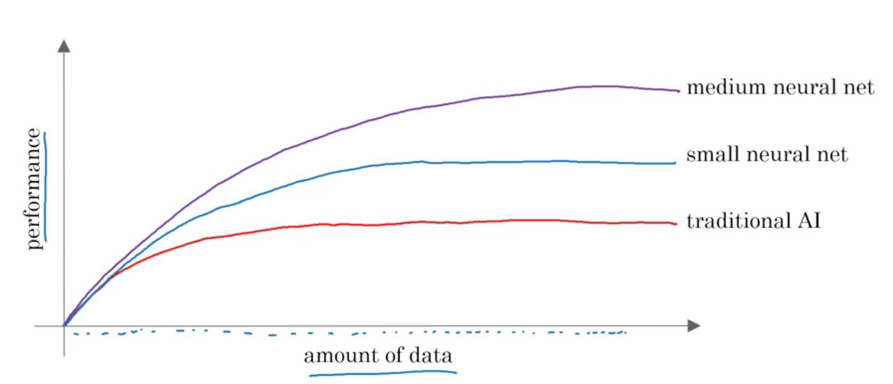
Why Now?

Slide 27
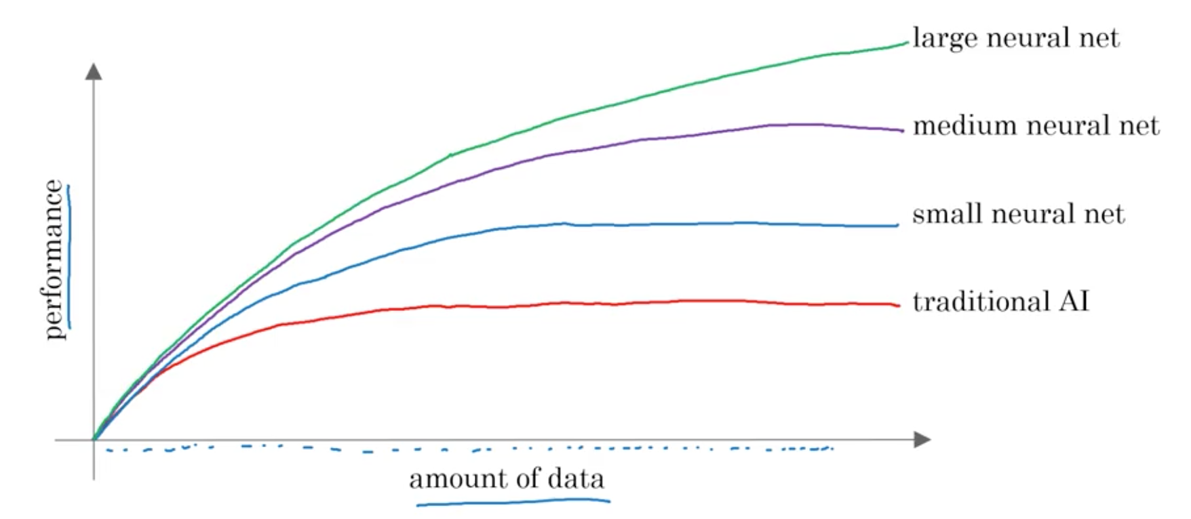
Why Now?

Slide 28
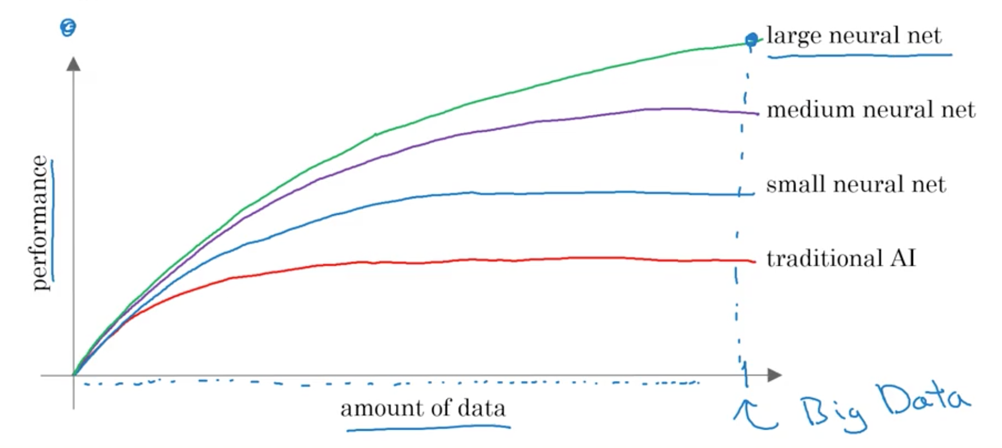
Why Now?

Slide 29
The Rise of Fast Computers
So, the rise of fast computers with specialized processors such as graphics processing units or GPUs has enabled many companies, not just giant tech companies, but many many other companies to be able to train large neural nets on a large enough amount of data in order to get very good performance and drive business value.

Slide 30
What is the most important
idea in AI?

Slide 31
Machine Learning

Slide 32
What is Supervised Learning?

Slide 33
A to B mappings
Input to Output mappings

Slide 34
What enables machine learning
to work so well?

Slide 35
What is Data

Slide 36
A Table of Data (Dataset)
Size of House (Square Feet) | Price ($1000)
523 | 115
645 | 150
708 | 210
1034 | 280
2290 | 355
2545 | 440
A | B

Slide 37
A Table of Data (Dataset)
Size of House (Square Feet) | # of Bedrooms | Price ($1000)
523 | 1 | 115
645 | 1 | 150
708 | 2 | 210
1034 | 3 | 280
2290 | 4 | 355
2545 | 4 | 440
A |  | B

Slide 38
Data is often unique to your business
Data is often unique to your business, and this is an example of a dataset that a real estate agency might have that they tried to help price houses.
It's up to you to decide what is A and what is B, and how to choose these definitions of A and B to make it valuable for your business.

Slide 39
Another example
If you have a certain budget and you want to decide what is the size of house you can afford, then you might decide that the input A is how much does someone spend and B is just the size of the house in square feet, and that would be a totally different choice of A and B that tells you, given a certain budget, what's the size of the house you should be maybe looking at.

Slide 40
A Table of Data (Dataset)
Size of House (Square Feet) | # of Bedrooms | Price ($1000)
523 | 1 | 115
645 | 1 | 150
708 | 2 | 210
1034 | 3 | 280
2290 | 4 | 355
2545 | 4 | 440
B |  | A

Slide 41

Acquiring data
Manual labeling

Slide 42
Acquiring data
From observing behaviors of humans
User ID | Time | Price ($) | Purchased
4783 | Jan 21 08:15.20 | 7.95 | yes
3893 | Mar 3 11:30.15 | 10.00 | yes
8384 | Jun 11 14:15.05 | 9.50 | no
0931 | Aug 2 20:30.55 | 12.90 | yes

Slide 43
Acquiring data
From observing behaviors of machines
Machine | Temperature | Pressure (psi) | Machine Fault
17987 | 60 | 7.65 | N
34672 | 100 | 25.50 | N
08542 | 140 | 75.50 | Y
98536 | 165 | 125 | Y
Input A |  |  | Input B

Slide 44
Acquiring data
Download from websites / partnerships
Thanks to the open internet you can find so many datasets available for free online
Computer vision or image datasets
Self driving car datasets
Speech recognition datasets
Medical imaging datasets
Keep in mind licensing and copyright

Slide 45


Use and misuse of data
Give me three years to build up my IT team, we're collecting so much data.
Then after three years, I'll have this perfect dataset.
We'll do AI then.
What’s wrong with this approach?

Slide 46
Use and misuse of data
It turns out that's a really bad strategy.
Once you've started collecting some data, go ahead and start showing it or feeding it to an AI team.
Then the AI team can give feedback to your IT team on what types of data to collect and what types of IT infrastructure to keep on building.

Slide 47
Example
Maybe an AI team can look at your factory data and say, "Hey. You know what? If you can collect data from this big manufacturing machine, not just once every ten minutes, but instead once every one minute, then we could do a much better job building a preventative maintenance systems for you.”
Machine | Temperature | Pressure (psi) | Machine Fault
17987 | 60 | 7.65 | N
34672 | 100 | 25.50 | N
08542 | 140 | 75.50 | Y
98536 | 165 | 125 | Y
Input A |  |  | Input B

Slide 48
Use and misuse of data
"Hey, I have so much data. Surely, an AI team can make it valuable."
What’s wrong with this statement?

Slide 49
Use and misuse of data
Unfortunately, this doesn't always work out.
More data is usually better than less data, but I wouldn't take it for granted that just because you have many terabytes or gigabytes of data, that an AI team can actually make that valuable.
Don't throw data at an AI team and assume it will be valuable.

Slide 50
Data is Messy
Not a cat
Not a cat
Cat
Cat

Slide 51
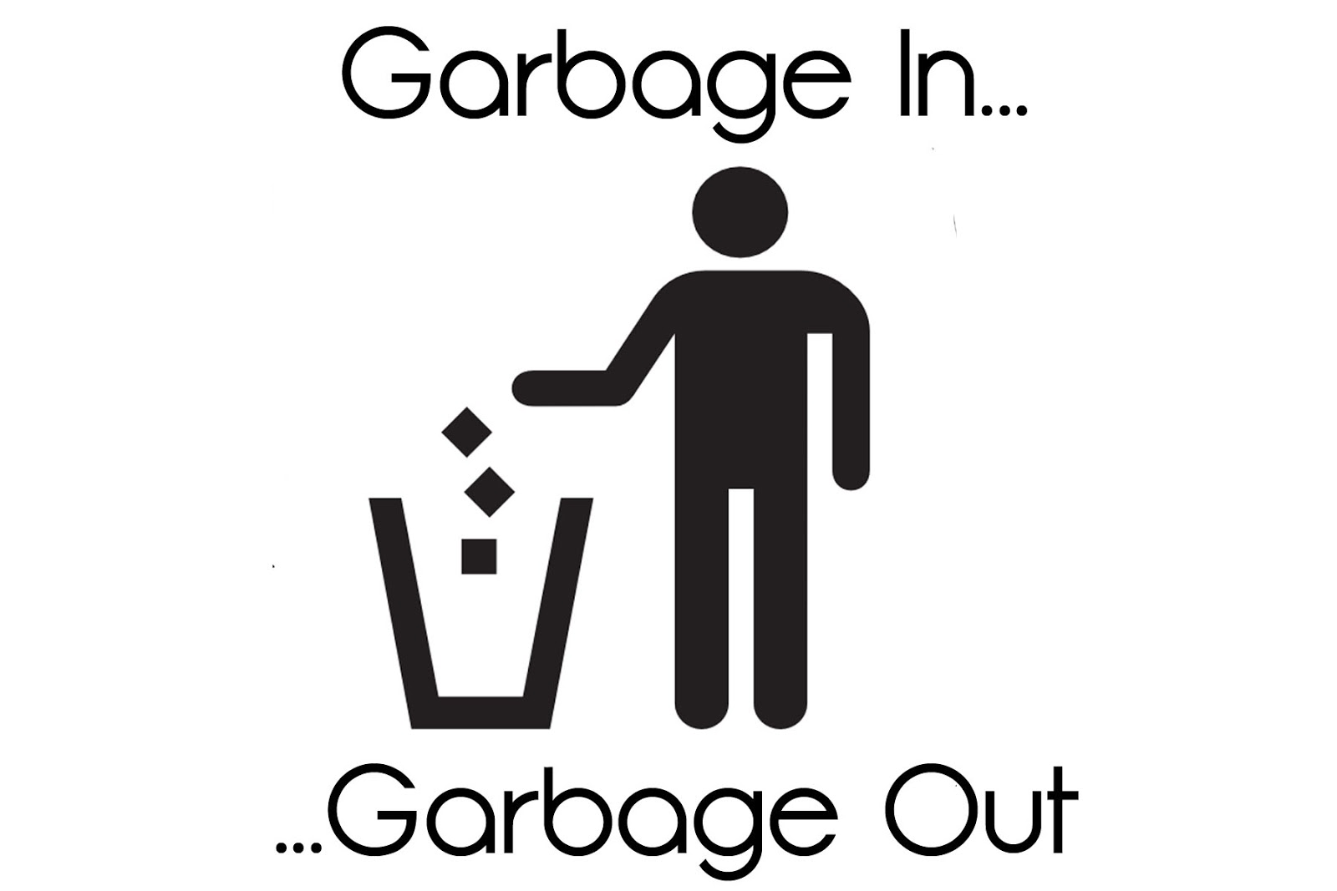
Data is Messy
If you have bad data, then the AI will learn inaccurate things.
Data problems:
Incorrect labels
Missing values
Multiple types of data
Unstructured Data: Images, audio, text

Slide 52
Example
Size of House (Square Feet) | # of Bedrooms | Price ($1000)
523 | 1 | 115
645 | 1 | 0.001
708 | unknown | 210
1034 | 3 | unknown
unknown | 4 | 355
2545 | unknown | 440
You can have incorrect labels or just incorrect data. For example, this house is probably not going to sell for $0.1 just for one dollar.
Or, data can also have missing values such as we have here a whole bunch of unknown values.
This is structured data.

Slide 53
The Terminology of AI
What do these terms mean?
Machine Learning
Data Science
Neural Networks
Deep Learning
You will be able to speak with others and start thinking about how these things could apply in your business.

Slide 54
Machine Learning vs Data Science
Size of House (Square Feet) | # of Bedrooms | # of Bathrooms | Newly Renovated | Price ($1000)
523 | 1 | 2 | N | 115
645 | 1 | 3 | N | 150
708 | 2 | 1 | N | 210
1034 | 3 | 3 | Y | 280
2290 | 4 | 4 | N | 355
2545 | 4 | 5 | Y | 440
A |  |  |  | B
Notes:
Mobile App to help people price houses
Machine Learning system: A > B

Slide 55
Running AI System
A software that which automatically returns output B for input A.
If you have an AI system running, serving dozens or hundreds of thousands or millions of users, that's usually a machine-learning system.

Slide 56
Data Science
If you want to have a team analyze your dataset in order to gain insights. The output of a data science project is a set of insights that can help you make business decisions
So, a team might come up with conclusions like:
"Hey, did you know if you have two houses of a similar size, they've a similar square footage, if the house has three bedrooms, then they cost a lot more than the house of two bedrooms, even if the square for this is the same."

Slide 57
Data Science
"Did you know that newly renovated homes have a 15% premium, and this can help you make decisions such as, given a similar square footage, do you want to build a two bedroom or three bedroom size in order to maximize value? "
"Is it worth an investment to renovate a home in the hope that the renovation increases the price you can sell a house for?"
The output of a data science project is a set of insights that can help you make business decisions, such as what type of house to build or whether to invest in renovation.

Slide 58
Machine Learning vs Data Science
Machine Learning
“Field of study that gives computers the ability to learn without being explicitly programmed.”
Arthur Samuel (1959)
A machine learning project will often result in a piece of software that runs, that outputs B given A.

Slide 59
Formal Definition of Data Science
Data science is the science of extracting knowledge and insights from data.
So, the output of a data science project is often a slide deck, the presentation summarizes conclusions for executives to take business actions or summarizes conclusions for a product team to decide how to improve a website.

Slide 60
Example of ML vs DS in the online ad industry
Large platforms have AI that quickly tells them what’s the ad you’re most likely to click on. This is a machine learning system. It inputs information about the user and about the ad and outputs whether the user will click on the ad or not.
These systems run 24/7 and drive ad revenue for these platforms.

Slide 61
Example of ML vs DS in the online ad industry
If analyzing data tells you, for example, that the travel industry is not buying a lot of ads, but if you send more salespeople to sell ads to travel companies, you could convince them to use more advertising, then that would be an example of a data science project.
The data science conclusion results in the executives deciding to ask a sales team to spend more time reaching out to the travel industry.

